Slide 1
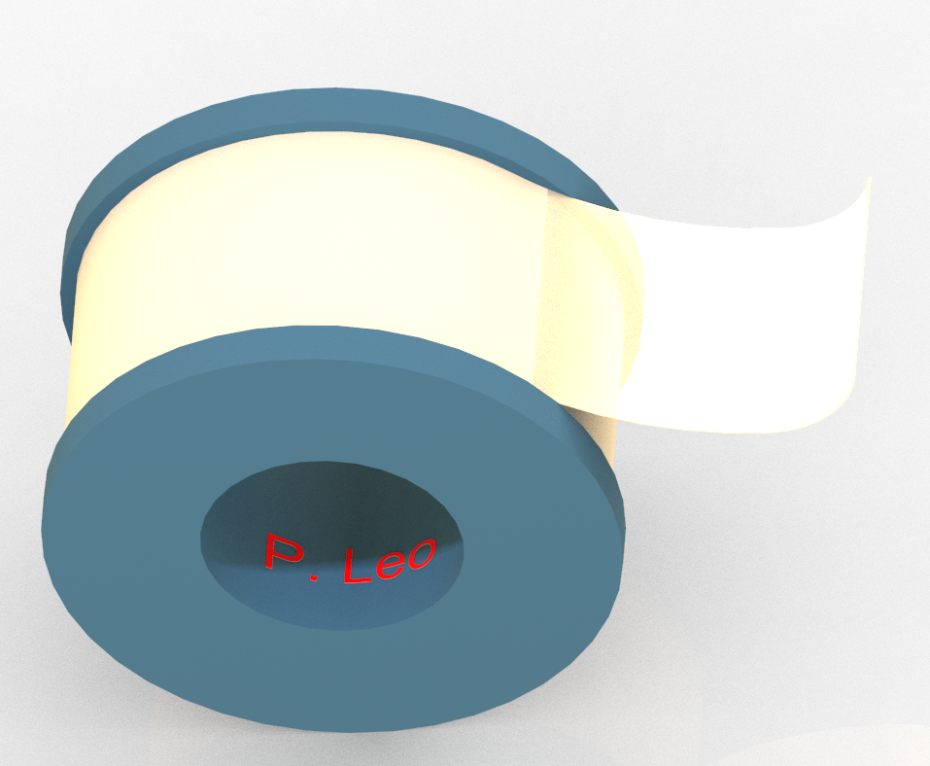
P. Leo 1P801H Electrical Tape
Thinner reinforced insulation alternative to your electrical insulation systems
Overview
Specifications
1P801H is a half mil (0.0125 mm) polyester (PET) film coated with acrylic pressure sensitive adhesive. We can also supply three layers for reinforced insulation as specified in IEC 60950.
Highlights
Flame retardant as per UL 510.
Used as UL class B electrical insulation systems (EIS).
The PET film (0.0125 mm thick) is significantly thinner than competitors, resulting thinner reinforced insulation systems.
Can apply two layers (0.0125 mm PET film x 2) for F83 EIS ground insulation.
RoHS compliance and halogen-free
Excellent adhesive properties.
Outstanding heat and solvent resistance.
High tensile strength.
For insulating and holding applications:
Transformers
Capacitors
Electric motors
Relay stabilizers
Electronic components
Where reinforced insulation is required
Properties | Units | Specifications
Color | - | Black or white
Total thickness | mm | 0.03 ± 0.003
Tensile Strength | N/25 mm | 45
Elongation | % | 58
Adhesion to steel | N/25mm | >6.5
Dielectric strength | kV | > 3.0
Temperature class | ºC | 130
UL class | - | Class B
UL 510 flame retardant | - | Pass
Test methods: in accordance with ASTM method
Shelf-life: 6 months when stored under 23ºC and 65% relative humidity

Slide 2
Application example:
Industries are demanding smaller transformer designs for electric vehicles, cell phones and wireless routers etc. Our 1P801H tapes are at least a magnitude thinner than conventional polyester (PET) films. Thus, the total thickness of reinforced insulation (in 3 layers) as per IEC 60950 using our tapes would be 0.09 mm, which is significantly thinner than using tapes from a key competitor (0.165 mm).
 | P. Leo 1P801H tape | Competitor PET tape
Polyester film thickness | 0.0125 mm | 0.025 mm
Total thickness (with adhesive) | 0.030 mm | 0.055 mm
UL temperature class | Class B | Class B
UL 510 flame retardant | Pass | Pass
Comparison between P. Leo 1P801H tape vs. PET tape from a key competitor
Reinforced insulation system made by 1P801H tape would be thinner than tapes
from a key competitor
Furthermore, two layers of the 1P801H tape (0.0125 mm PET film x 2) can be applied for F83 EIS ground insulation.
Contact:
Mainland China (Same as WeChat): +86 13360687771 (Ms Jenny Ho)
North America: +1 (970) 3718146 (Mr Scott Mundfrom)
Hong Kong: +852 2604 8222
Email: sales@pleo.com
P. Leo & Co., Ltd. | Unit 210, 8W, Hong Kong Science Park, Shatin, N.T., Hong Kong
Factory.| No. 3 Rui Wah Road, Tian Keng, Heng Li, Dongguan, Guangdong, China 523206
Copyright® 2024 P. Leo & Co., Ltd. All rights reserved.

